Slide 1


REM
ED
1

Slide 2

Cardiovascular Health Monitoring System
Under Supervision of Dr. Mahmoud Hanafy
2

Slide 3
Presented
by
Mina Moheb Sadek
Eman Gamal Hussin
Noor Allah Mohamed
Hala Abdeen Mostafa
Marawan Abd Elsalam
Ahmed Khaled EL Attar
202000557
202000135
202000119
202001392
201900086
201700264
3

Slide 4
Agenda
1)INTRODUCTION
2)HARDWARE
3)MOBILE APPLICATION
4)AI
5)API
6)FUTURE WORK & CONCLUSION
4

Slide 5
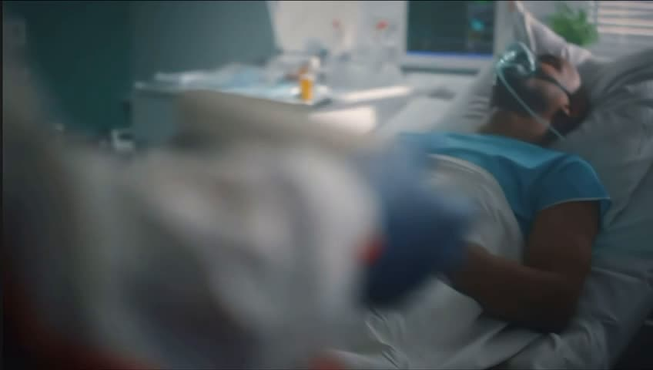
5

Slide 6
Our Triple Goal
EEE
6

Slide 7

Early Detection and Proactive intervention
Our
Goals
Empower Users and
reduse Their Hospital visits
Enhance Medical
Consultaions
7

Slide 8
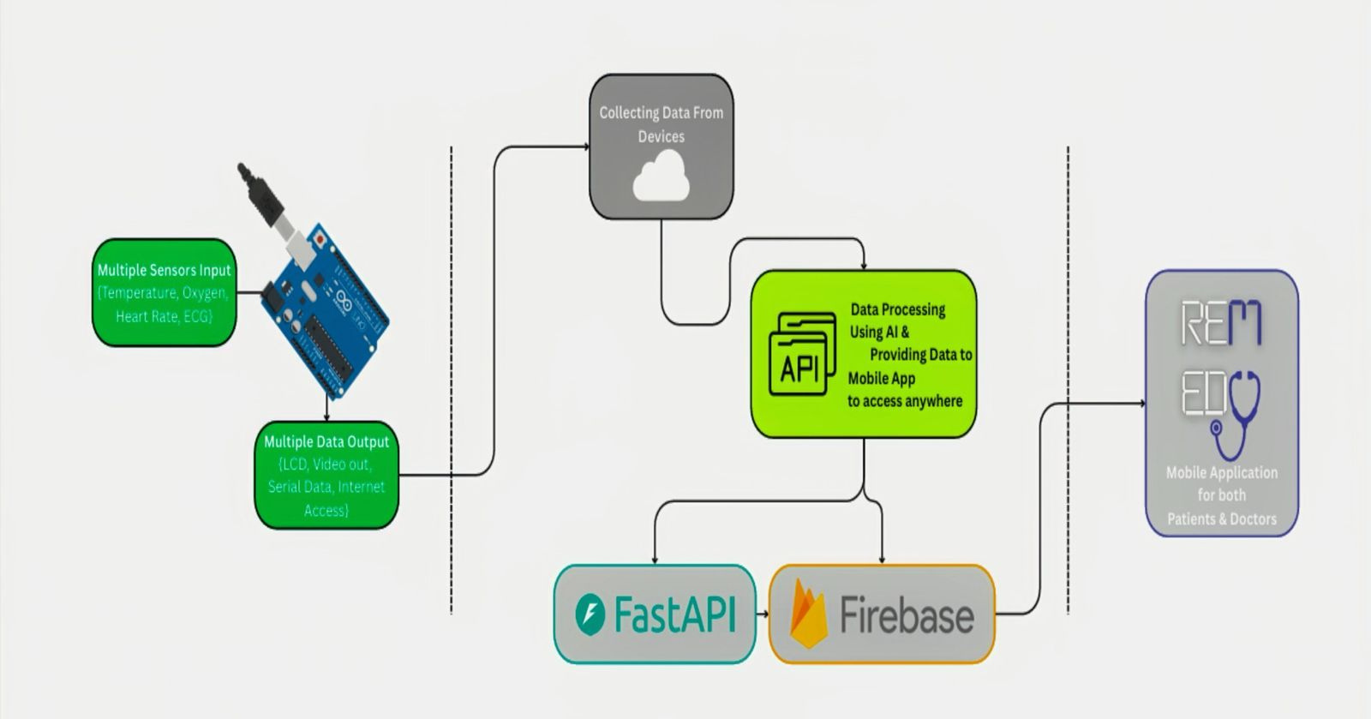
8

Slide 9
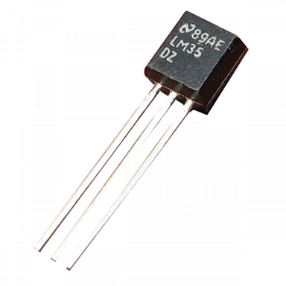

HARDWARE
LM 35 Sensor
PURPOSE:
MEASURES HUMAN BODY TEMPERATURE.
HOW IT WORKS:
ANALOG SENSOR THAT OUTPUTS VOLTAGE LINEARLY PROPORTIONAL TO TEMPERATURE.
WHY IT'S USED:
LOW-COST SENSOR.
OUTPUTS ANALOG VOLTAGE EASILY READABLE BY ARDUINO.
9

Slide 10
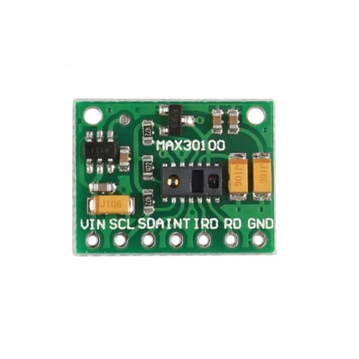
HARDWARE
MAX30100 Pulse Oximeter
PURPOSE:
A DIGITAL SENSOR THAT MEASURES SPO₂ AND HEART RATE.
HOW IT WORKS:
COMBINES TWO LEDS (RED AND IR).
MEASURES LIGHT ABSORPTION BY BLOOD.
WHY IT'S USED:
IT GIVES QUICK RESULTS AND SENDS THE DATA DIRECTLY TO THE ARDUINO.
IT’S SMALL, EASY TO USE, AND WORKS WITH JUST A FINGERTIP.
10

Slide 11
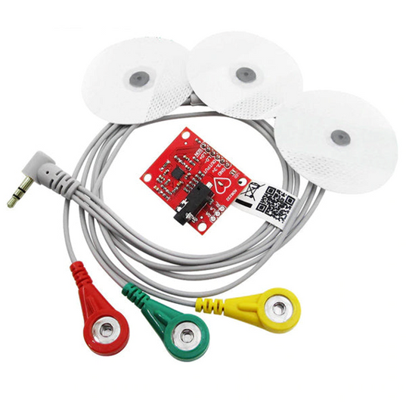
HARDWARE
ECG Sensor
PURPOSE:
CAPTURES ELECTRICAL SIGNALS FROM THE HEART.
HOW IT WORKS:
USES ELECTRODES TO DETECT BIOELECTRICAL IMPULSES.
OUTPUTS ANALOG ECG SIGNAL WAVEFORM.
WHY IT'S USED:
CRITICAL FOR MONITORING CARDIAC HEALTH.
11

Slide 12
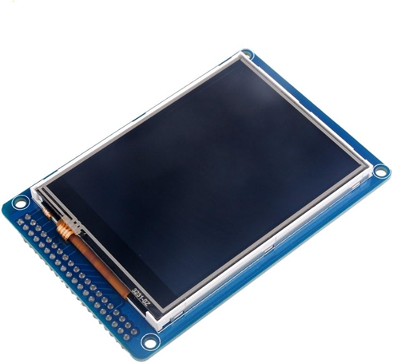
HARDWARE
TFT LCD Display
PURPOSE:
VISUAL DISPLAY OF REAL-TIME HEALTH DATA.
HOW IT WORKS:
RECEIVES DATA FROM ARDUINO.
DISPLAYS TEMPERATURE, ECG WAVEFORM, SPO₂ READINGS.
WHY IT'S USED:
IMMEDIATE FEEDBACK ON HEALTH DATA.
12

Slide 13
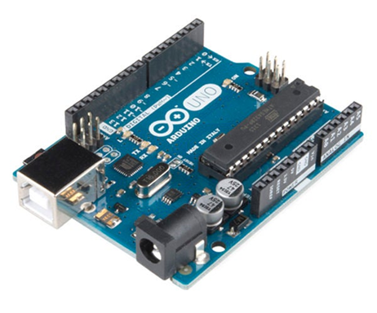
HARDWARE
Arduino Uno
PURPOSE:
MAIN MICROCONTROLLER (BRAIN OF THE DEVICE).
HOW IT WORKS:
IT READS DATA FROM THE SENSORS (LIKE TEMPERATURE, ECG, AND BLOOD OXYGEN).
IT PROCESSES AND SENDS THE DATA TO THE DISPLAY.
WHY IT'S USED:
LOW-COST MICROCONTROLLER.
EASY TO PROGRAM.
13

Slide 14
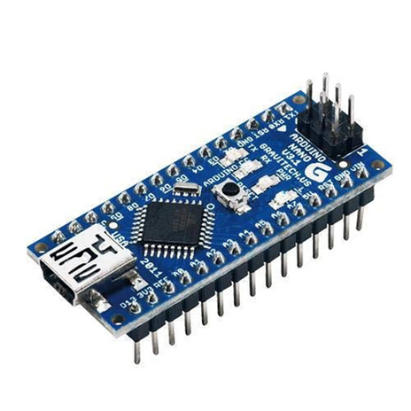
HARDWARE
Arduino Nano
PURPOSE:
COMPACT CONTROLLER FOR DISPLAY CONTROL.
HOW IT WORKS:
MANAGE TFT DISPLAY OR COORDINATE BETWEEN TWO UNOS.
WHY IT'S USED:
SMALL FORM FACTOR.
EFFICIENT FOR LIGHTWEIGHT, DISPLAY-FOCUSED TASKS.
14

Slide 15
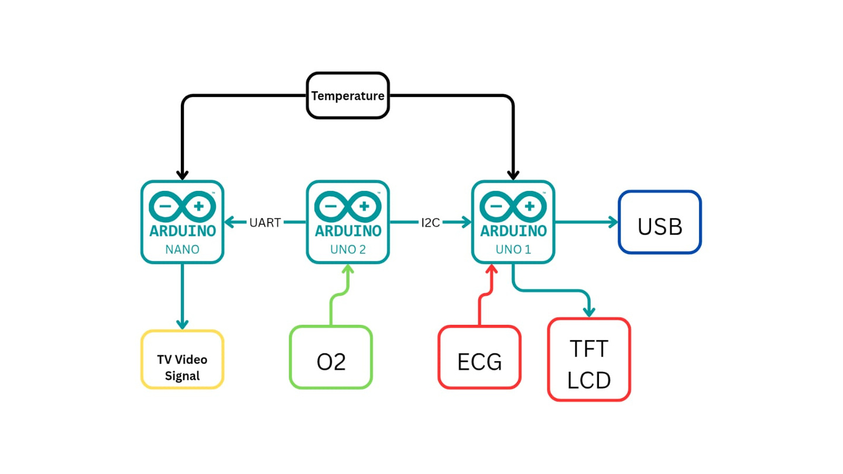
DATA FLOW
15

Slide 16


REM
ED
16

Slide 17

17

Slide 18



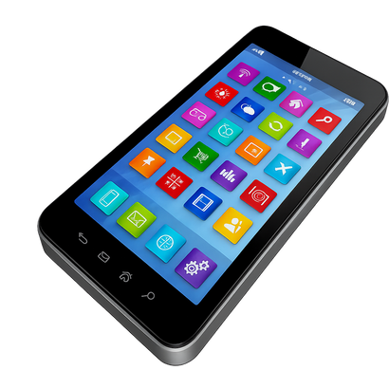


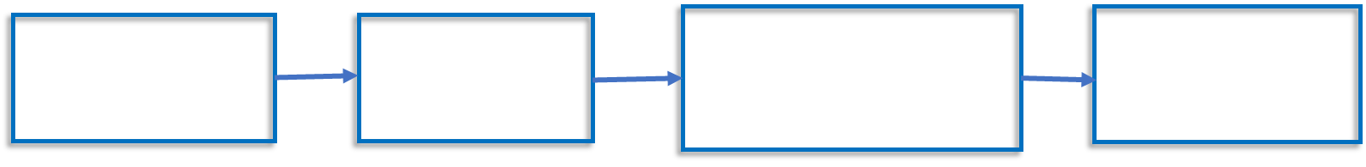
18

Slide 19


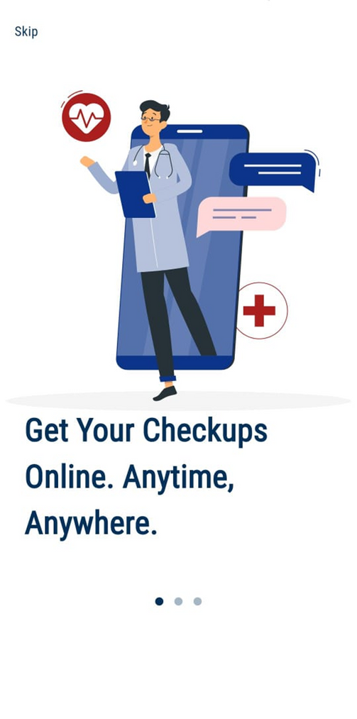

19

Slide 20
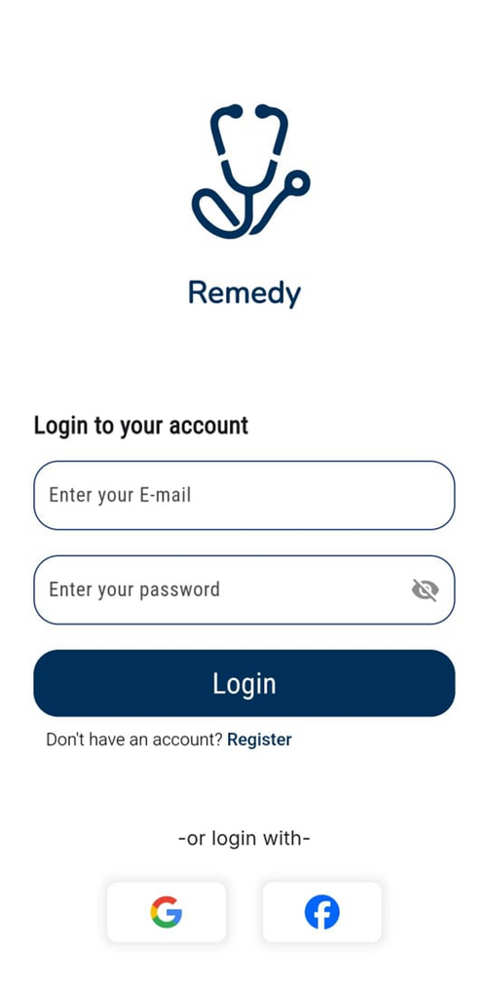
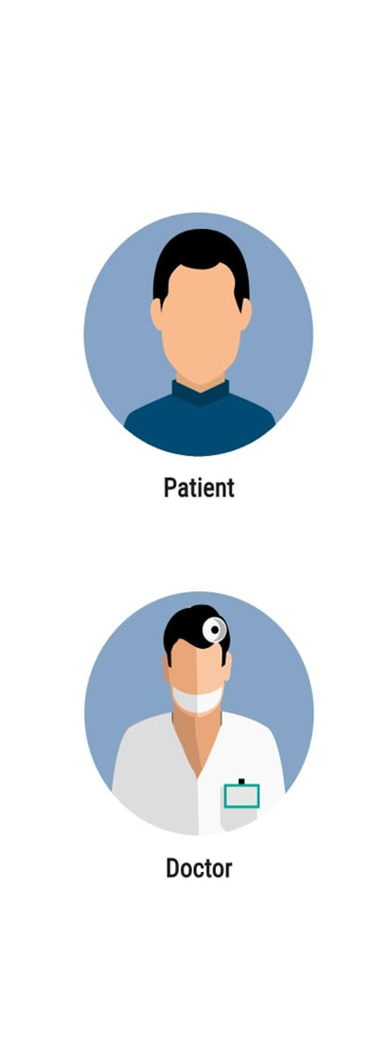
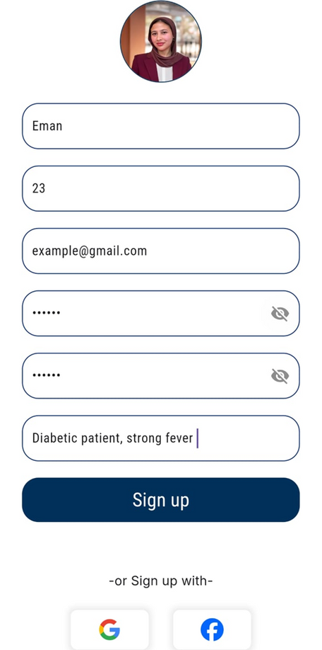
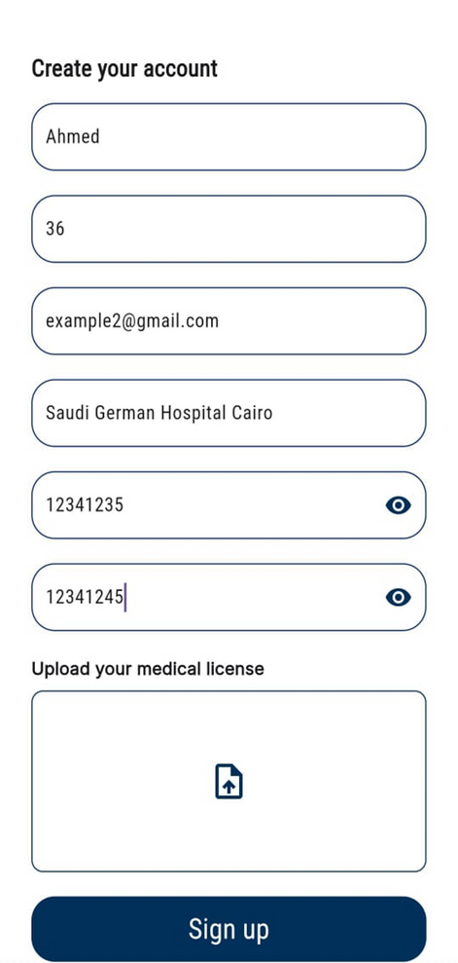
20

Slide 21
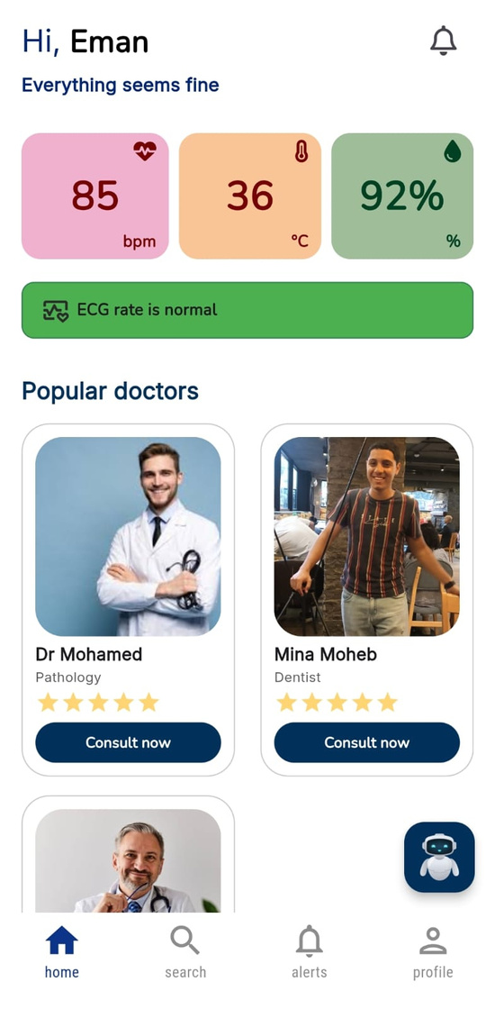
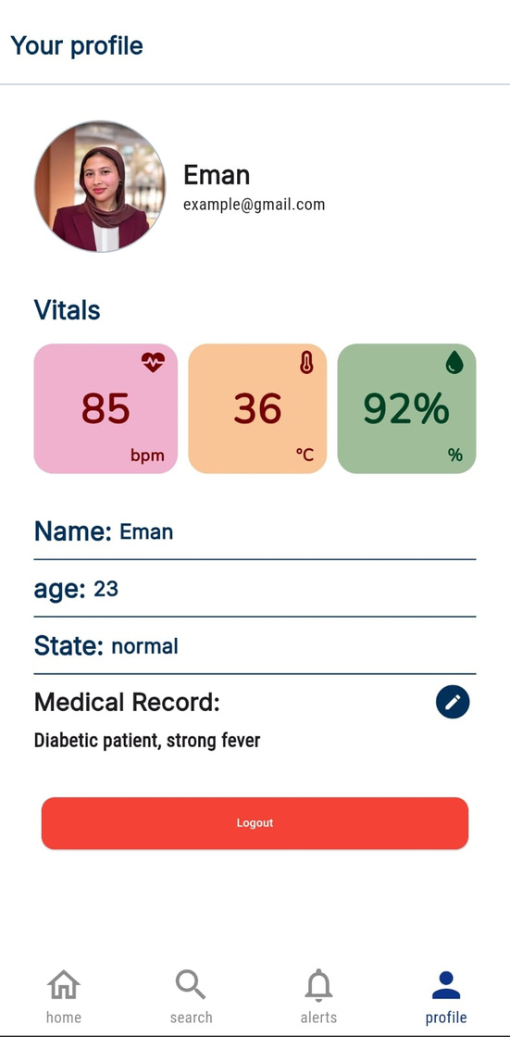
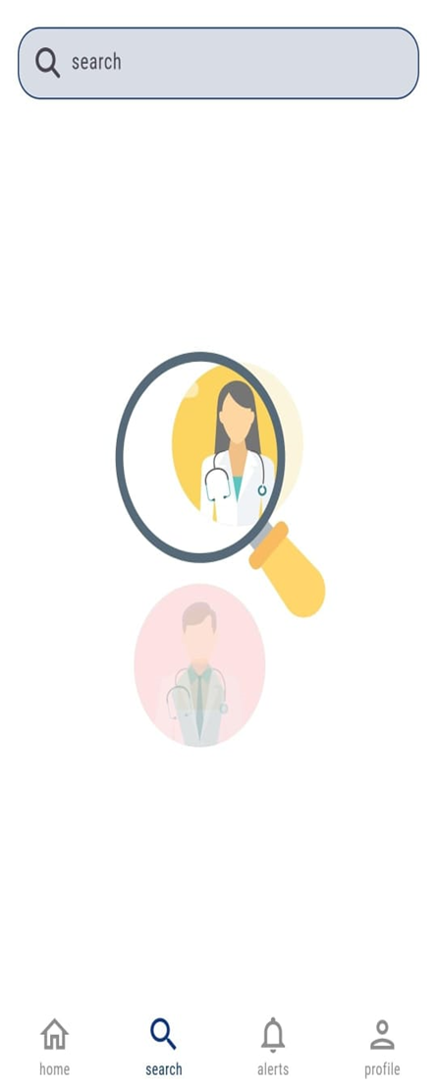
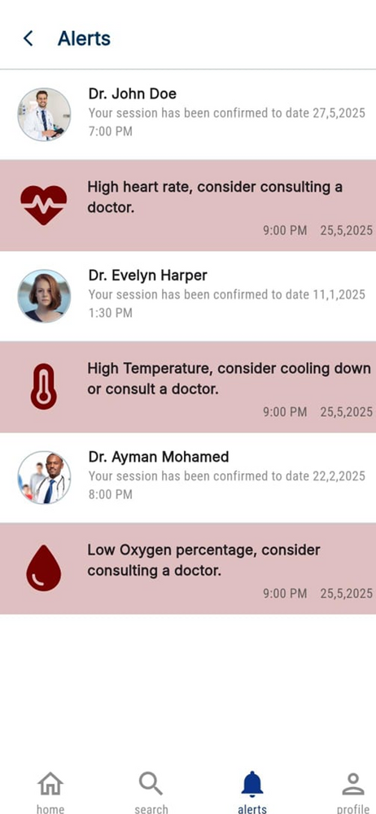
21

Slide 22
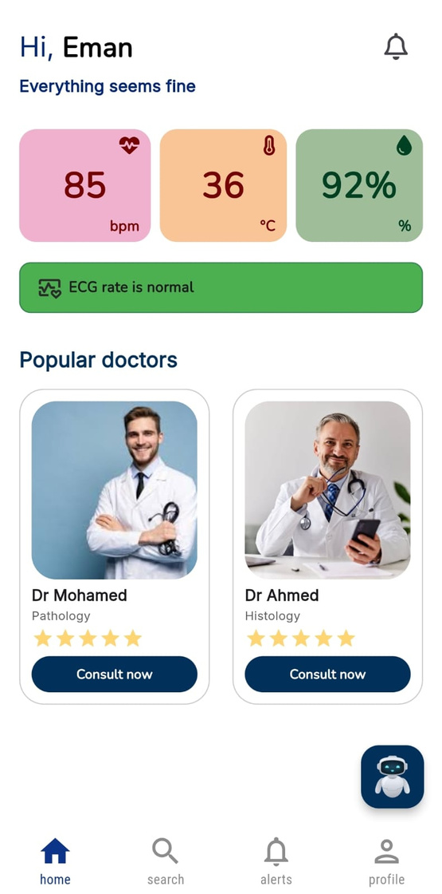
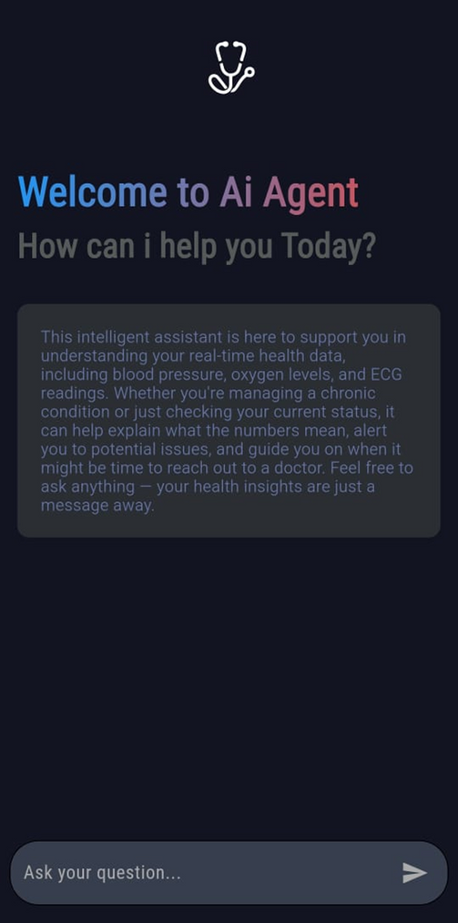


22

Slide 23
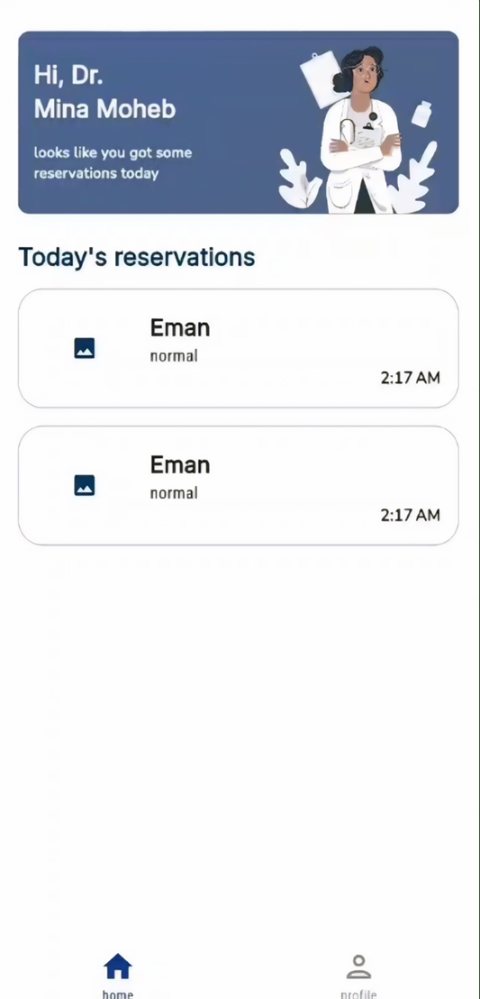
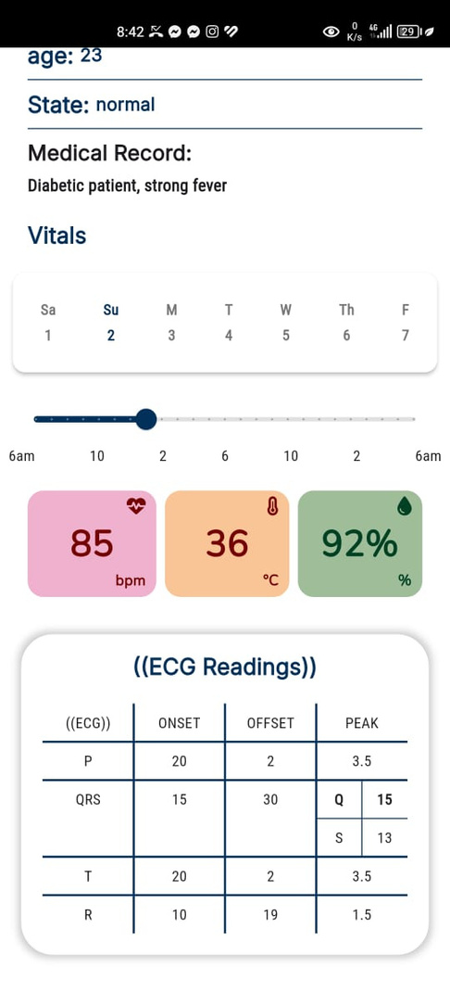
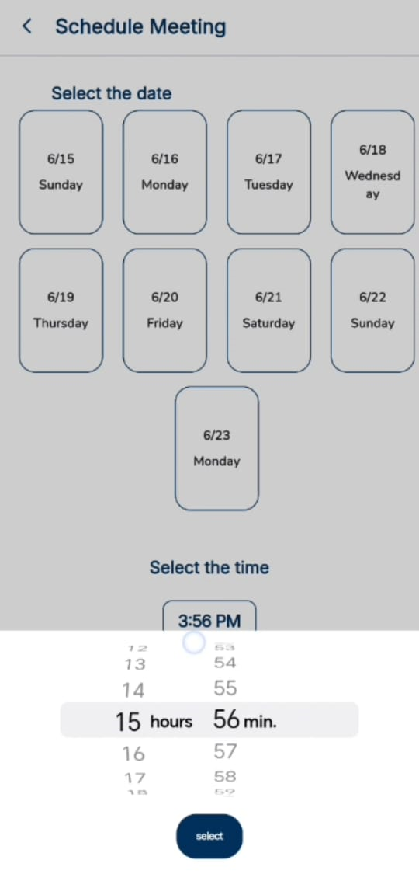
23

Slide 24
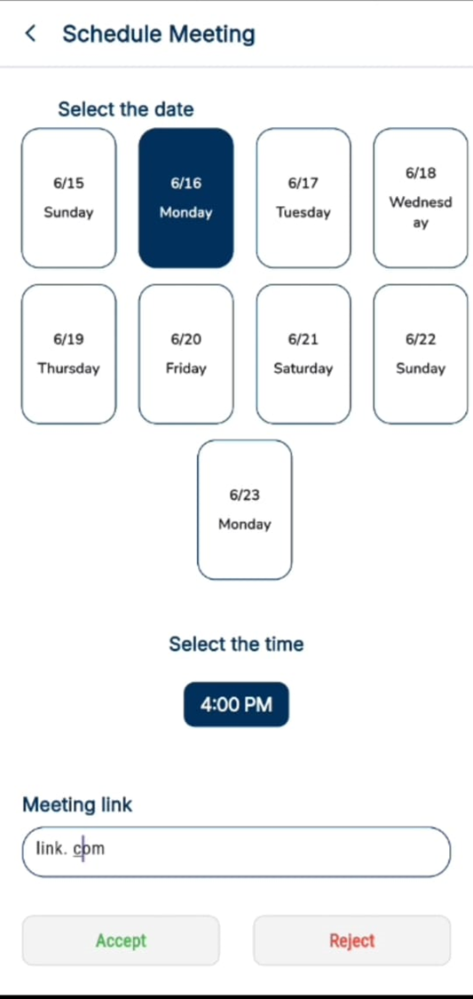
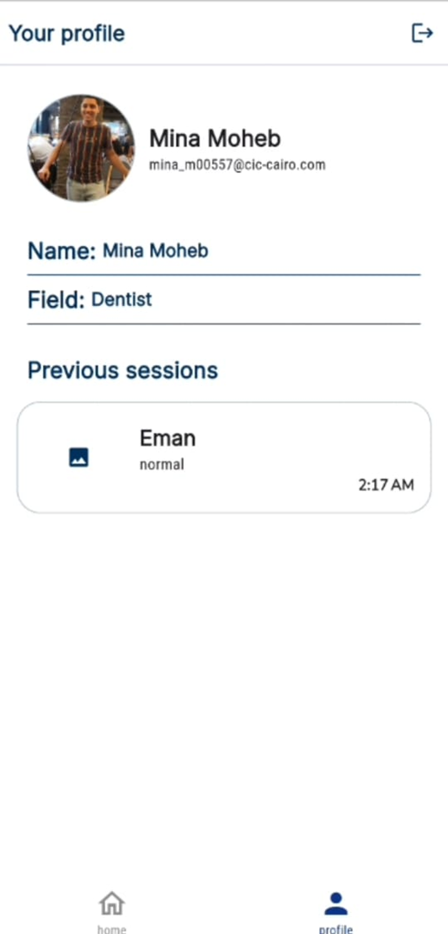
24

Slide 25
ARRHYTHIMA CLASSIFICATION
USING:
CONVOLUTIONAL DENOISING AUTOENCODERS
25

Slide 26
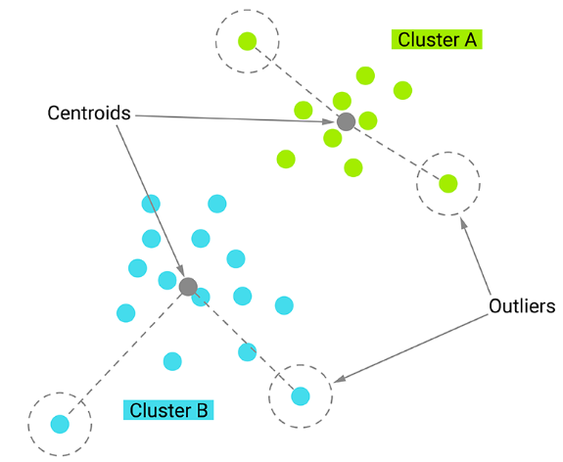
CLASSIFICATION
OBJECTIVE: PREDICT A LABEL
OR CATEGORY FOR AN INPUT.
METHOD: USE HISTORICAL DATA THAT HAS KNOWN (LABELED) OUTCOMES.
26

Slide 27
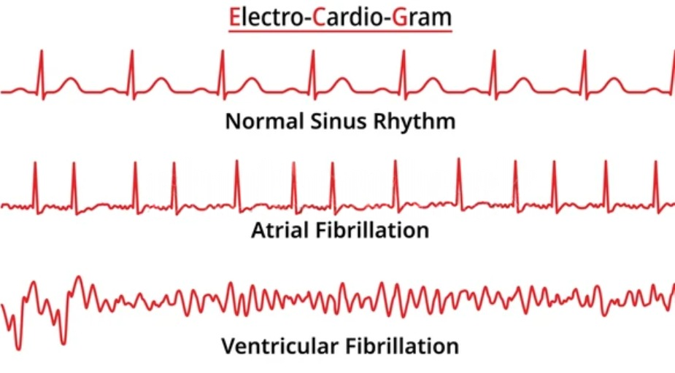
CDAES
OBJECTIVE: ENHANCE ECG SIGNAL QUALITY BY REMOVING NOISE.
METHOD: USE MODELS THAT DENOISE SIGNALS, LEADING TO IMPROVED HEARTBEAT CLASSIFICATION ACCURACY.
27

Slide 28
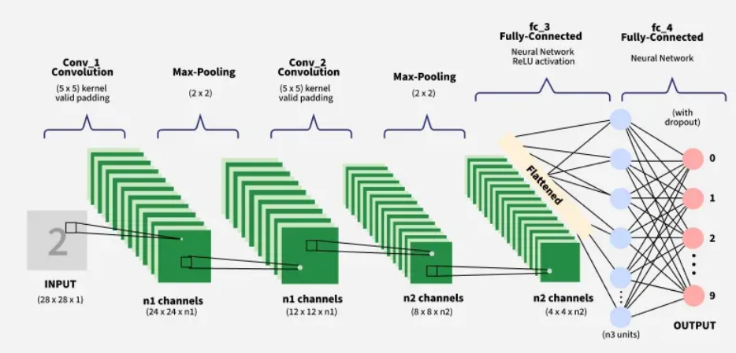
CNN
OBJECTIVE & METHOD: USES CONVOLUTIONAL LAYERS TO DETECT PATTERNS
28

Slide 29
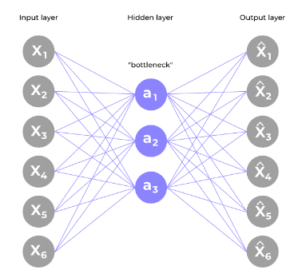
AUTOENCODER
OBJECTIVE: PERFORM DIMENSIONALITY REDUCTION AND DATA RECONSTRUCTION.
METHOD:
USE AN ENCODER TO COMPRESS INPUT.
USE A DECODER TO RECONSTRUCT THE ORIGINAL DATA FROM .
29

Slide 30



App
Hardware
REM
ED
30

Slide 31


Budget - £E-
Components | Quantity | Price(EGP) | Total cost
LM 35 | 1 | 100-230 | 100-230
O2 MAX30100 | 1 | 300-600 | 300-600
ECG kit | 1 | 640-1000 | 640-1000
Arduino UNO | 1-2 | 540-750 | 540-1500
Arduino nano | 1 | 375-450 | 375-450
LCD | 1 | 330-600 | 330-600
Hardware SubTotal |  |  | 2285-4380
31

Slide 32

FUTURE WORK
32

Slide 33
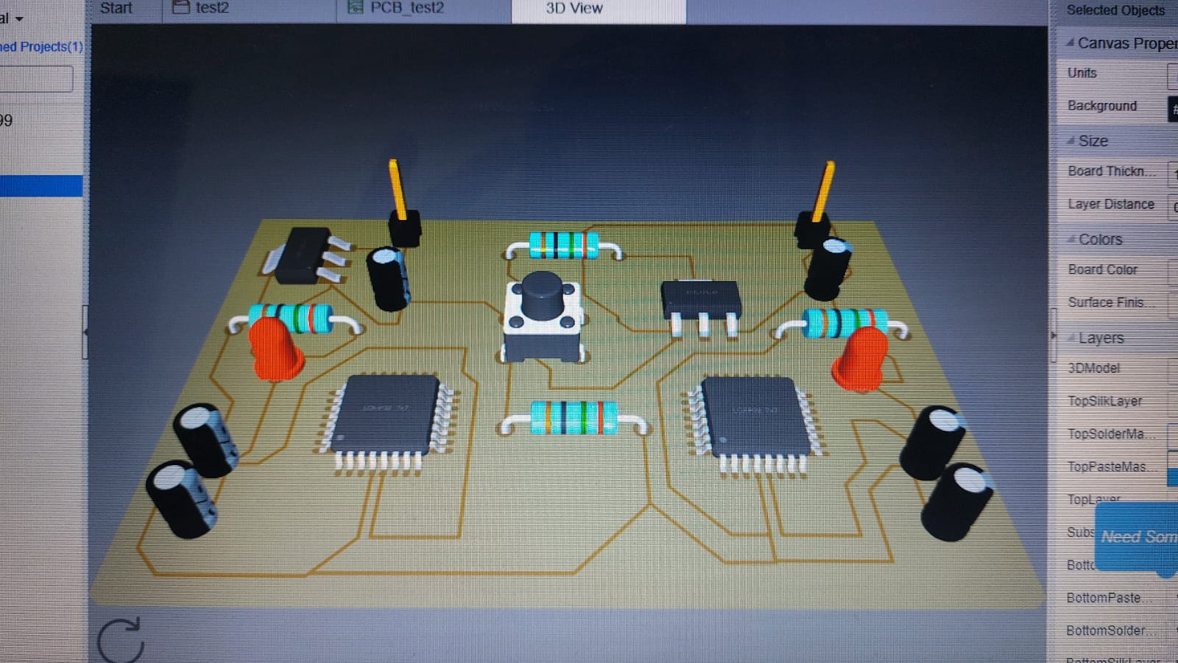
PCB
33

Slide 34
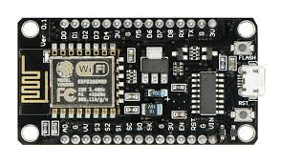
WI-FI MODULE
34

Slide 35

BATTERY
35

Slide 36

MULTILINGUAL
36

Slide 37

APP PUBLISHING
37

Slide 38
CONCLUSION
_DESIGN AND IMPLEMENTATION OF A HEALTH MONITORING KIT
_REAL-TIME DATA MONITORING
_FOLLOW-UP FEATURES
_SCHEDULE MEDICAL APPOINTMENTS
_AI DETECTION
38

Slide 39

Thank you
39

